Slide 1


Using Classification And Regression Trees (CART) and
Decision Trees an Introduction
Dave King PhD
Robust Design
&
Bill Messina, PhD
Supplier Quality Assurance
July 22, 2009
Copyright © 2008 Raytheon Company. All rights reserved.
Customer Success Is Our Mission is a registered trademark of Raytheon Company.

Slide 2
Presentation Outline
1) Why Do You Use Decision Trees
What is a Decision Tree?
3) Splitting algorithms recursive partitioning using Gini & Entropy
Example of how to compute impurity
Model over fitting
Concept of Cross-validation
Pruning the tree
Regression Trees
9) Introduction to R Software – how to implement procedure.

Slide 3
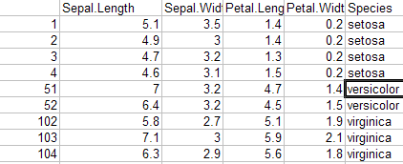
Traditional Dataset Analysis
1) Why Decision Trees??
Example of a PRISTINE DATASET:
All variables have entries, there are no blank entries, and the data is carefully and thoughtfully taken.
This is a NICE Dataset!!
All Rows are filled in.
There are no missing values!!

Slide 4
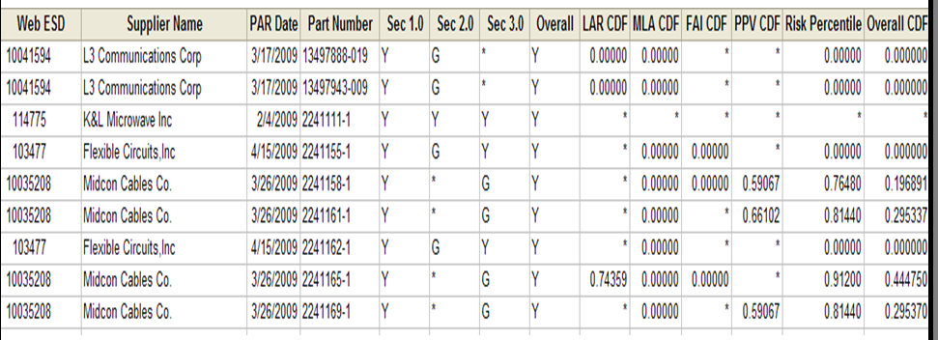
Dirty Dataset
Why Decision Trees??
This is What We are Going to Talk About:
All variables have entries, there are no blank entries, and the data is carefully and thoughtfully taken.
Blank Entries all over the place
no values, for whatever reason.
Look! Somebody stuck some
Chewing gum in the data!
This is a Classic Example of Dirty Data.
In practice, real datasets will have missing values and problems.
In the real world, Dirty data is the norm not the exception.
CART is a perfect application for this type of situation

Slide 5

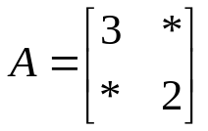
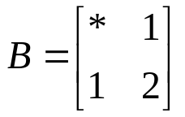
How do you Analyze Dirty Data??
Why Decision Trees??
Decision Trees are good at analyzing Dirty data because the algorithms depend
On pivot tables – not matrix multiplication.
Classical methods such as Regression or ANOVA utilize what is known as a Linear Model
X and Y are matrices which have no missing entries
Classical Methods will not work!!
Here is why:
Let A and B be matrices with missing values. For example,
Let A and B be the matrices:
With an * standing for missing value.
What is the matrix product AB? What is the matrix Inverse A⁻¹?
Matrix operations are not defined when matrix entries are missing

Slide 6
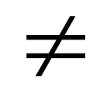
Decision trees use Pivot Tables to construct models
Why Decision Trees??
Even if there are missing values in a Table of Data,
one can still construct an excel pivot table.
Since Decision trees use Pivot tables, it is impervious to Missing values
Because missing values in a pivot table are not tallied in the overall count.
This does not mean that missing values are “good”.
It just means that decision trees will work, when matrix based methods fail.
Decision trees will not correct for Lies or Untruths in the data.
No model will take away the effect of corrupt data.
Corrupt data Dirty Data
The classical (matrix based) alternative to decision trees is to
fill in missing entries in a matrix by imputation methods
one imputation method is interpolation
Decision Trees are a good model for Dirty Data type applications.

Slide 7
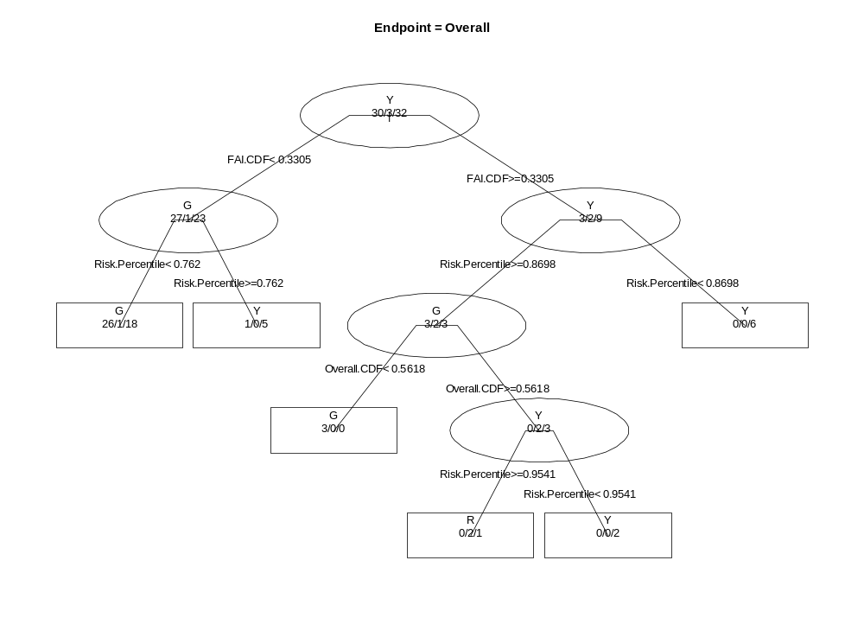


2) What is a decision tree?
A real tree (upside)
A decision tree
Root
Root
node
Branches
Leaves
Branch
nodes
Leaf (or terminal)
nodes

Slide 8
What is a decision tree?
Here is an example of a decision tree
To Read the tree – start at the very top.
If the FAICDF column < 0.3305 go to left
If, on the other hand, FAICDF>= 0.3305 go right
On the first left branch node, look at Risk%.
If the Risk Percentage < 0.762 go left again
And classify “Overall” as G
If, on the other hand, Risk Percentage >= 0.762
Take a right and Classify overall as “Y” …….

Slide 9
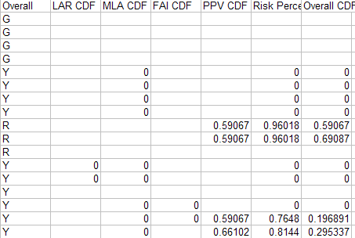
A decision tree dataset example
The “Y” we want to analyze is the Overall PAR Rating.
(In this case the “Y” is
Categorical).
The X’s are quantitative in this example, but can also be categorical in a decision tree.
Y
X1
X2
X3
X4
X5
X6
We want to Predict Y based upon any of the X variables, assuming they are known.
We also want to come up with the best model with reasonably low error.
We will discuss what we mean by that later.

Slide 10
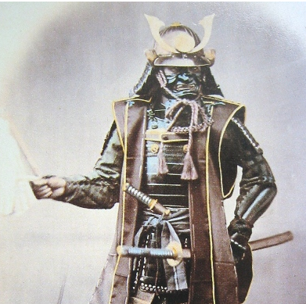
3) Splitting algorithms and recursive partitioning
The Decision tree builds a “Model” one variable at a time.
We start out looking a “slice” of the Data with respect to the X1 variable.
In the case of the previous data set the Y variable is a category {“G”,”R”,”Y”}.
The computer (pretend its a samurai) looks to cut the data with a samurai sword.
The samurai is allowed to slice the data only “in between” each of the data points.
How does the Samurai know where to “cut” the data?
G
Y
Y
Y
Y
Y
G
R
G
G
Y
G
Y
Y
R
Y
Y
G
Y
G
Y
G
Y
G
G
* * *
X1 Axis
Computer
Samurai
Could cut here
Or here
Or here
Or lastly here
* * *

Slide 11

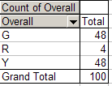
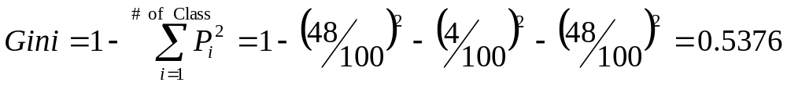
4) Example of how to compute impurity
A good samurai slice is one which maximizes the change in Impurity
Consider the “Gini” index which is one way to measure Impurity:
Not this Gini, the
mathematical version of Gini.
To measure the change in impurity we first look at what the GINI index is before the Samurai slice.
BEFORE SLICE
This is also the Gini index associated with the root node.
The Gini Index measures how “IMPURE” a node is

Slide 12

Compute impurity after the split
* * *
G
Y
Y
Y
Y
Y
G
R
G
G
Y
G
Y
Y
R
R
Y
Y
G
Y
G
Y
G
R
Y
G
G
X1 Axis
Here is one of the spots the samurai could “cut” the data
The samurai cuts the data in every spot he can for X1, then he does the same thing for every variable.
Lets compute the change in Gini index for one of the spots the samurai could make a cut.

Slide 13

Recursive partitioning using Gini
In this example the change in Gini is negative.
Impurity after the cut is higher than the impurity before the cut.
The samurai would not like this cut
The samurai will always choose the split producing the largest POSITIVE
The computer then computes for all of the other X variables: X2, X3 ….
Preferred samurai cut = highest positive change
in IMPURITY for all X variables at every split point.

Slide 14
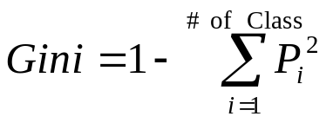
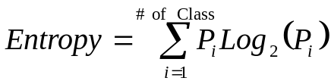

There are other measures of “IMPURITY”
In the “mini example” below we measured the impurity of a node by the Gini Index defined to be:
Another measure of impurity is based off of Shannon’s Theory of Information.
In the case the Information gain measure is used, the cut is selected to maximize the information gain
The decision tree selection process works the same way regardless of the measure we utilize

Slide 15
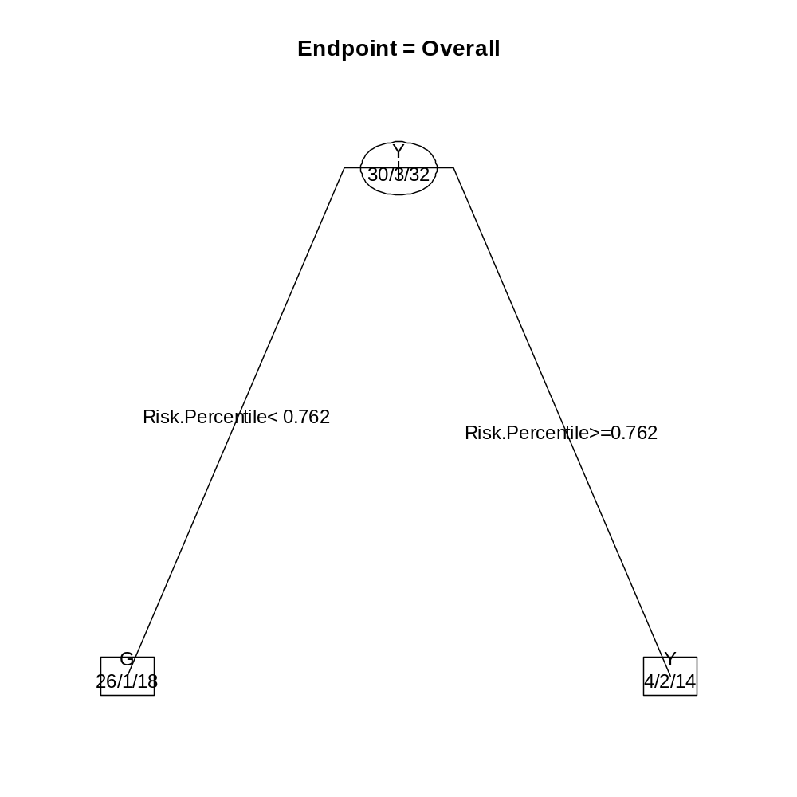
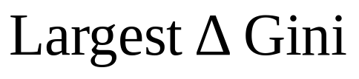
Overview Of How CART Works
Risk percentile has
Samurai Cuts at Risk percentile = 0.762
The numbers on the bottom tell the reader how many G’s, R’s and Y’s there are in each node. (alphabetically ordered)
For example, 26/1/18 means 26 G’s, 1 R and 18 Y’s.
The predicted class = class with the majority of “votes”.
The First Cut of the Tree

Slide 16
Overview Of How CART Works
The initial split
The next split …
The next split …
….
Another split …
….
The process is repeated at each node until a very large and complicated tree is grown
Notice that the splitting process can continue until the leaf nodes are totally “pure”.
A tree which has totally “pure” nodes has 0% misclassification (R² = 1).

Slide 17

How the Tree handles Missing Values & Surrogate Variables
Now that we have discussed how the tree is built we need to
understand how the decision tree handles missing data.
When the samurai cuts the data he always prefers to
Maximize the change in impurity. Suppose that
(Risk Percentile) is the variable that maximizes the change
In impurity.
What do we do if (Risk Percentile) is MISSING?
For example:
Risk.Percentile is missing … What are we
going to do now?
Since the samurai can’t choose the Best variable, he will use a
variable which gave him the second best change in impurity.
The variable with the second best change in impurity
Is called the surrogate variable.
The tree uses the surrogate splits when the algorithm is unable
to use the primary split due to missingness.

Slide 18
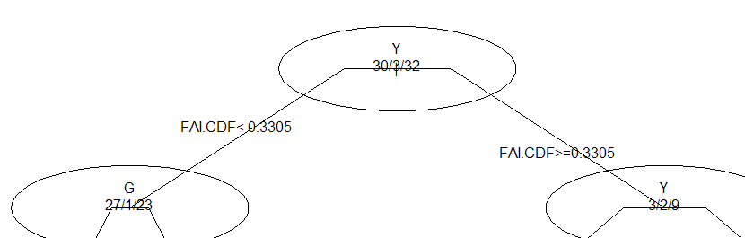
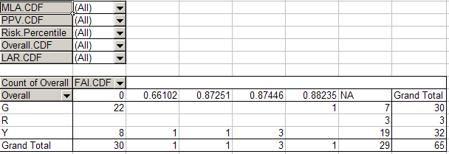
Surrogate Splits
Example of how Surrogates Work:
Here is the first split of a tree
30/3/32
27/1/22
3/2/10
First Samurai cut
Notice that under the first samurai cut:
Left of Cut:
Right of Cut:
22/0/8
1/0/5
UNKNOWN/Missing category
7/3/19
What do we do with the Unknowns or Missings? Ans: Use the surrogate split

Slide 19

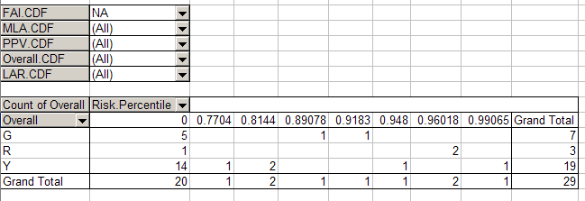
Surrogate Splits
Example (continued):
According to the Computer the Second Best Splitting Point
which has the
Second Samurai cut
Left of Cut:
Right of Cut:
From Splitting on Primary Variable:
22/0/8
1/0/5
From Splitting on Surrogate Variable:
+
5/1/14
2/2/5
Total:
27/1/22
3/2/10
The Tree Attempts to categorize all of the data it can.
If there is missing data in one variable it will try and split on surrogate variables

Slide 20
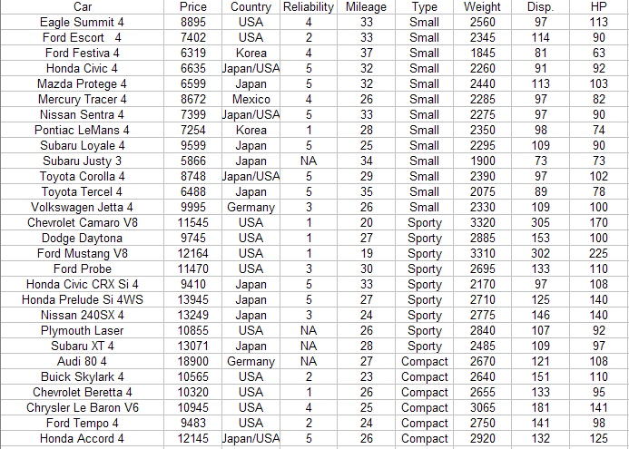
Example 2 : The Car Dataset – A Nice Dataset
From consumer reports 1990

Slide 21
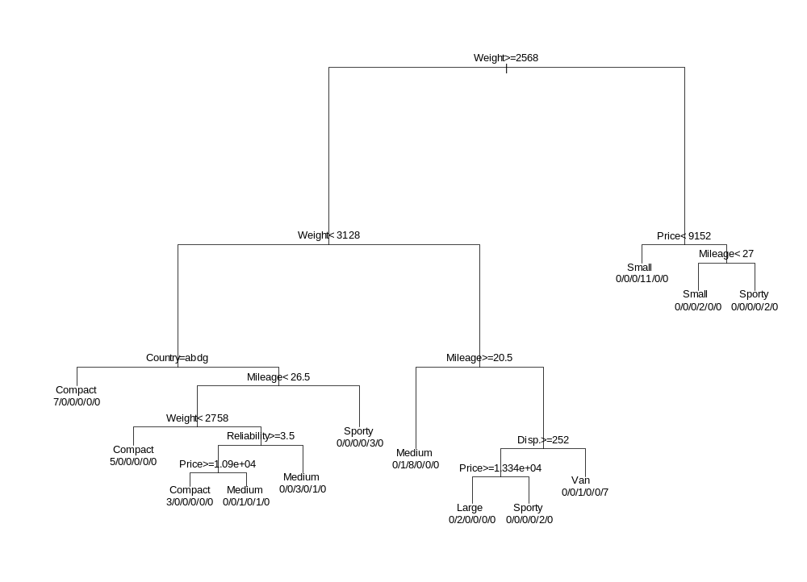
Another example of a complex Decision tree
Complicated model “fit the data” well, however, this model is OVERFIT to the data
An over fit model is a model which has “pure” nodes,
but it predicts NEW OBSERVATIONS poorly, because it is fit to the “noise”.

Slide 22
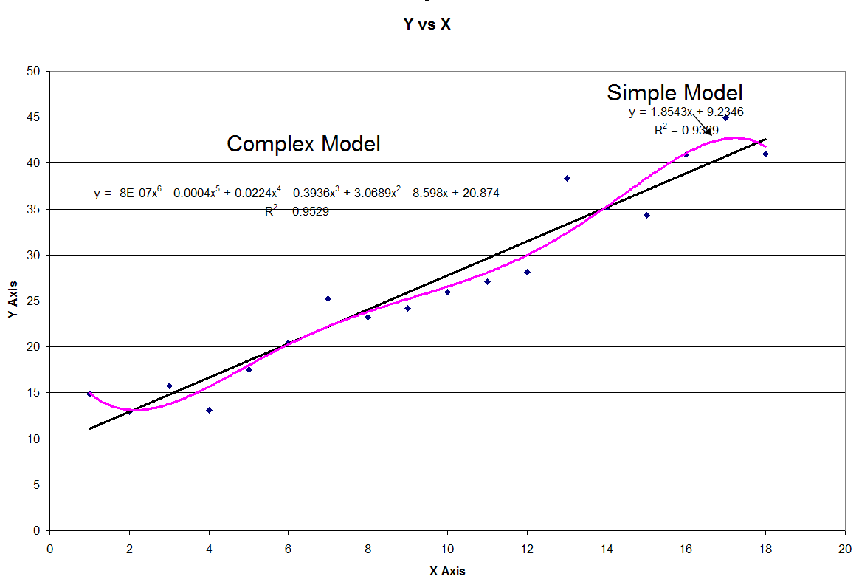
Problems with Complex Models
Taylor’s Theorem:
There exists a polynomial which snakes its way through every single data point (that model has
R² = 1!!)
Complex Model = High R² but very low prediction accuracy
Complex Models are “fit to noise”

Slide 23
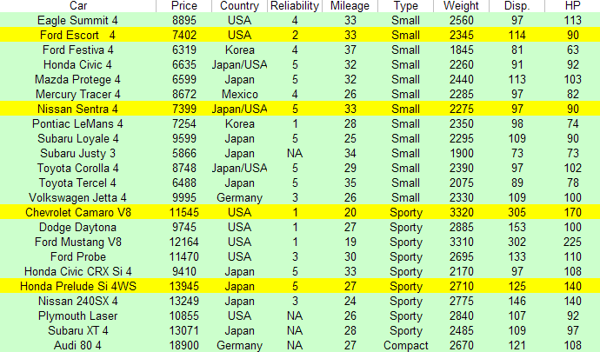
5) How do you know whether a model is “overfit”?
How do measure how well a model Predicts new outcomes??
IDEA:
Randomly divide your dataset into two pieces: The “training chunk” (green) and the “test chunk” (yellow)
Use the “training” piece of the dataset to build the model (which is the tree).
Use the “yellow rows” as the test rows to see how well the tree predicts new observations.
Use the Yellow rows of data to assess how well the tree
Predicts outcomes which were not in the training dataset.
Build the decision tree with the green rows of data

Slide 24
6) Concept Of Cross-Validation Error
3-fold Cross-validation
Dataset
Divide it into 3 equally sized chunks
Training
Data
Training
Data
Test
Data
Training
Data
Test
Data
Training
Data
Test
Data
Training
Data
Training
Data
K-Fold cross-validation is where we split dataset into K equally sized pieces

Slide 25

Cross-Validation
Data not involved in model building
Data used to build the Tree
Cross-validation measures the predictiveness of a model because:
The Test data was not used to build the model so
Test data simulates NEW FUTURE OBSERVATIONS.
In K-fold cross-validation a total of (K+1) models are built
The first K models are used to compute the cross-validation error
The last model, (K+1 model) is the tree built using all of the data.

Slide 26
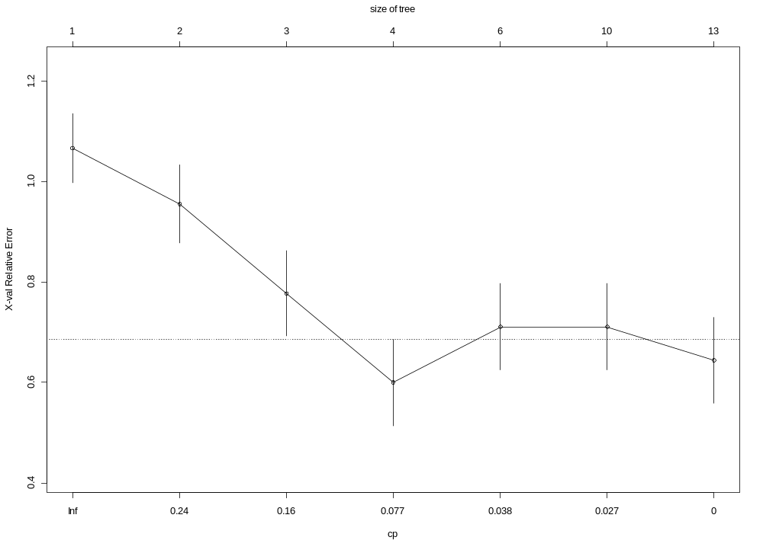
Cross-Validation Graph
Size of Tree
Increasing Model Complexity
Size of tree = # of nodes
The Best model
Cross-validation Error
Complexity Parameter

Slide 27
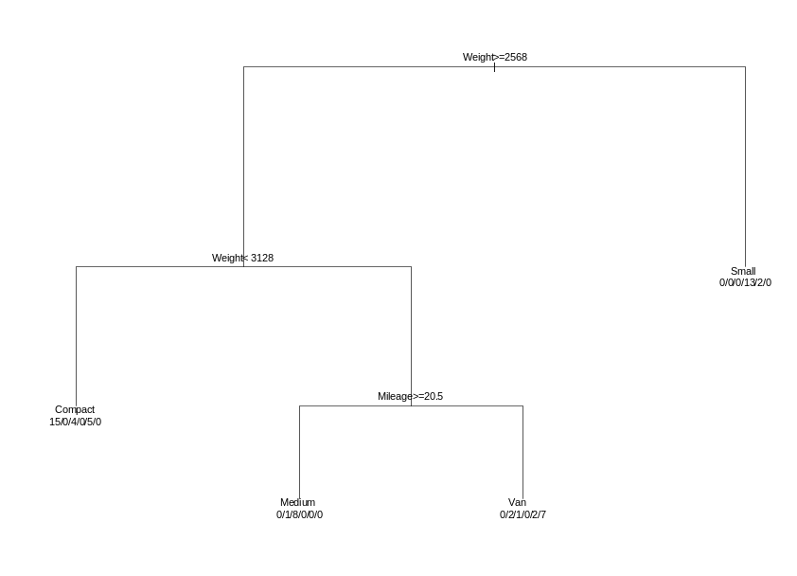


7) Pruning A Decision Tree
Un-pruned Tree
Pruned Tree
Weight>=2568
|
Weight< 3128
Price< 9152
Mileage< 27
Small
0/0/0/11/0/0
Small
Sporty
0/0/0/2/0/0
0/0/0/0/2/0
Country=abdg
Mileage< 26.5
Mileage>=20.5
Compact
7/0/0/0/0/0
Weight< 2758
Reliability>=3.5
Sporty
Disp.>=252
Compact
0/0/0/0/3/0
Medium
5/0/0/0/0/0
Price>=1.09e+04
Medium
0/1/8/0/0/0
Price>=1.334e+04
Van
Compact
Medium
0/0/3/0/1/0
0/0/1/0/0/7
3/0/0/0/0/0
0/0/1/0/1/0
Large
Sporty
0/2/0/0/0/0
0/0/0/0/2/0
The Best Model
Ockam’s Razor: When one is confronted With several different possible interpretations of
a phenomena, the simplest interpretation is usually the correct one

Slide 28
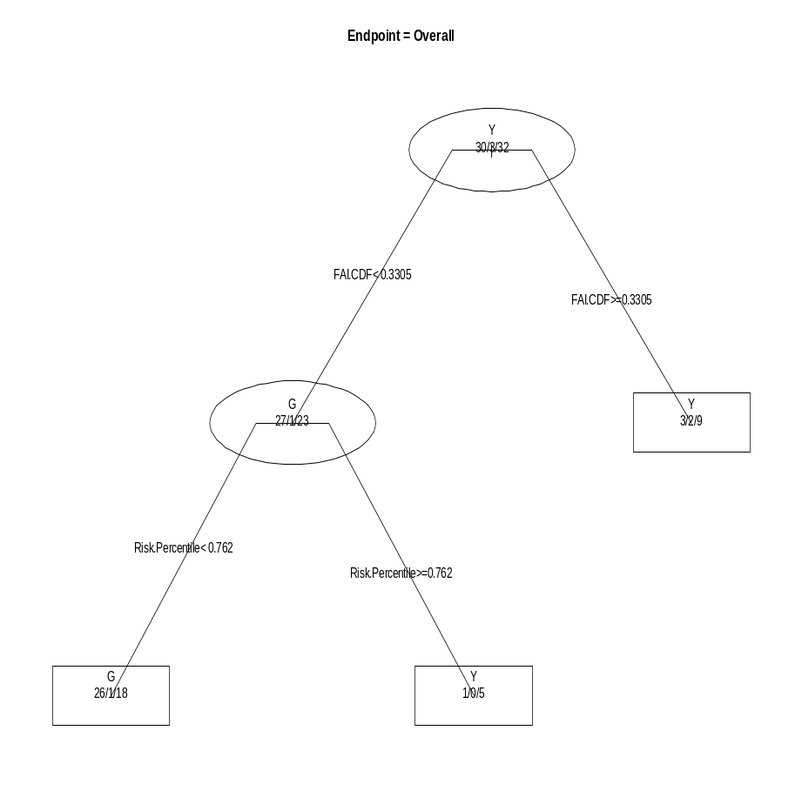
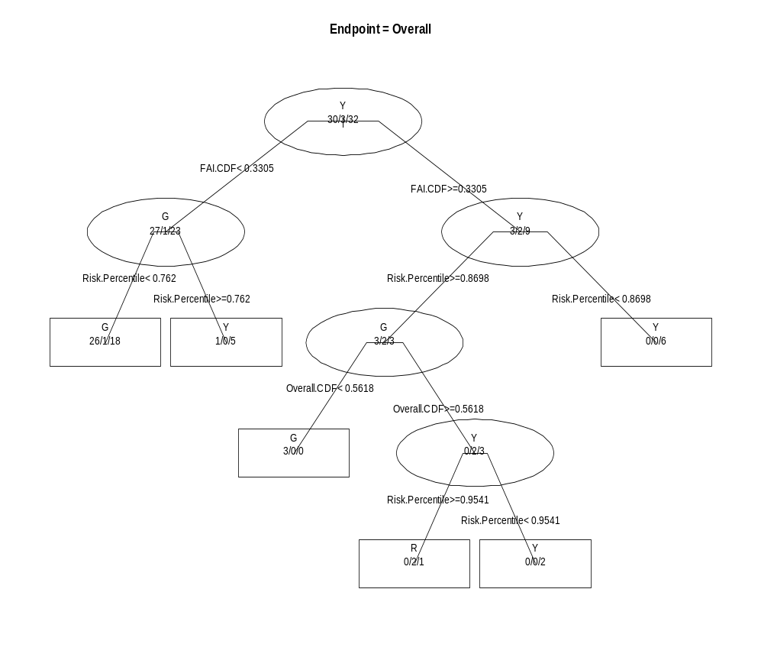
7) This is the Pruned Tree for the Dirty Dataset
Un-pruned Tree
Pruned Tree
The Best Model

Slide 29
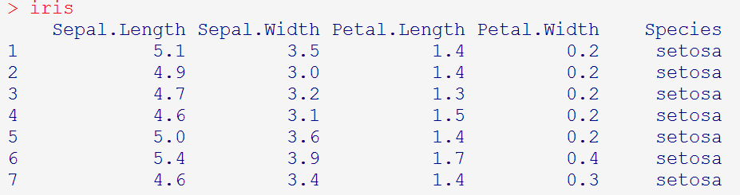
8) The Regression Tree
CART stands for Categorical and Regression Trees
So far we’ve thoroghly talked about Categorical Trees,
now lets discuss Regression trees
Regression Trees are used when Y is continuous.
Example: IRIS DATASET
….. ….. ….. ….. ………… etc etc etc …………….
Model: treefit=rpart(Sepal.Length~.,data=iris)
Y = Sepal.Length
X-variables = Everything else

Slide 30
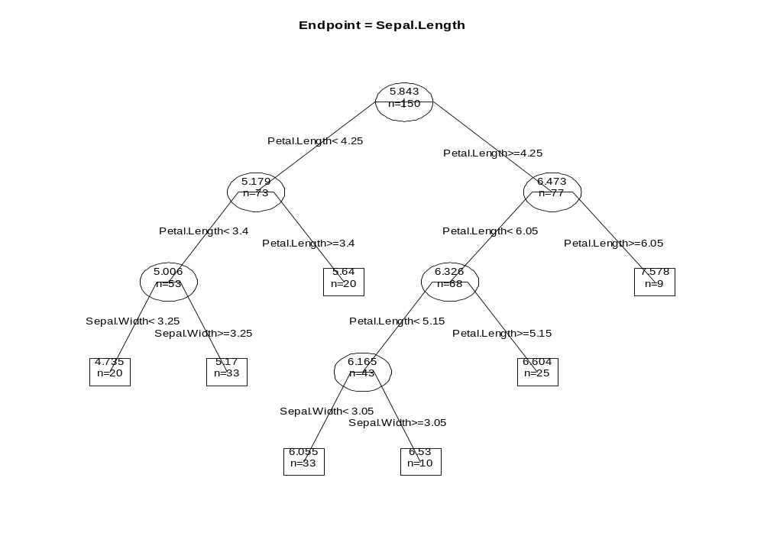
Picture of a Regression Tree
Prediction at a node is a single number (= avg of Y responses in the node)
Example: If {Petal Length < 4.25} AND {Petal Length < 3.4} AND {Sepal.Width < 3.25}
then PREDICTED Y = 4.735

Slide 31
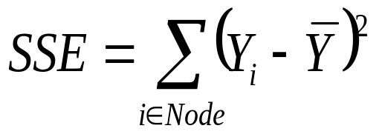
Comparison Between Regression Tree and Classification Tree
Classification Tree
Regression Tree
Best split point is determined from
minimizing impurity of each node
Best split point is determined from
minimizing sum of squared error
in each node
Prediction is winner of vote tally at each
node, prediction is a category
Prediction is the average value of
Observation in the node
Example: If {Petal Length < 4.25} AND {Petal Length < 3.4} AND {Sepal.Width < 3.25}
then PREDICTED Y = 4.735

Slide 32
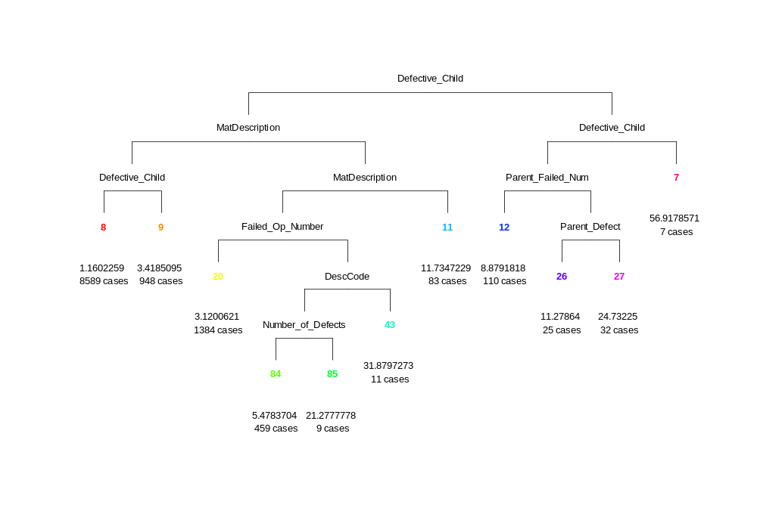
A Pragmatic Example
Rework is a big problem here at RMS.
We gathered the last months data on rework hours.
Here is a decision tree with Y = Rework Hours
Rework
Hour ave = 56.9
Defective child is a smoking gun X variable for rework
This half of the tree is
where rework hours are big

Slide 33
Details on the “Big Rework” problems
The big rework node is node 7
The defective child entries for node 7 are:
Defective_Child= { FPA CRYOSTAT ASSY,
GPS AIDED INERTIAL NAV SYS (GAINS),
LO1 RF CCA,
TUBE CLAMP CUSHION 7
15684.560
56.917860
<Blank> }
This example illustrates that decision trees can be used to identify issues

Slide 34
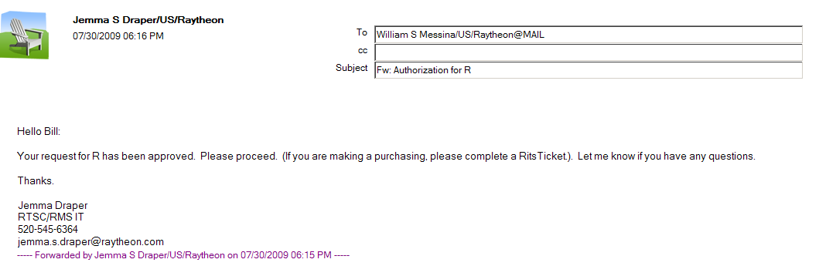
9) Implementing the Decision Tree in R
Permission Granted to utilize R software.

Slide 35
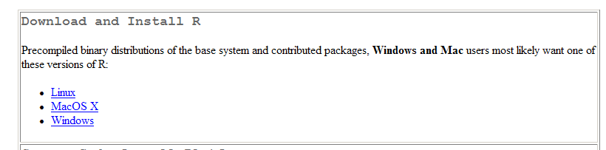
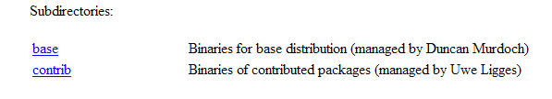
Implementing the Decision Tree in R
Step 1. Download R from the internet.
You can type in “Download R” in Google or go to the link below.
http://cran.r-project.org/
The “Home” page of R.
Click
Click
Step 2. You have now downloaded R onto your computer!!
The price for downloading R is $0.00

Slide 36
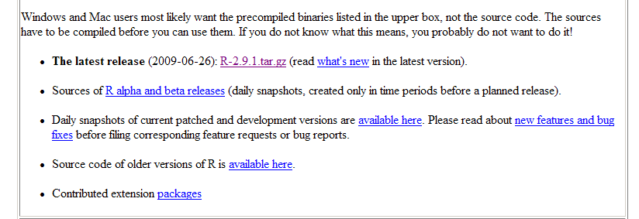
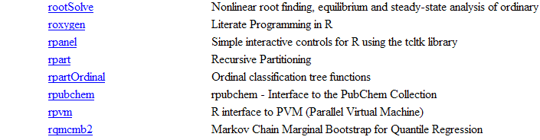
Implementing the Decision Tree in R
Step 3. Once you have downloaded R.
You will need to download some contributed extension packages.
The link for extension packages is on the home page of R.
Click
Download
The rpart package

Slide 37
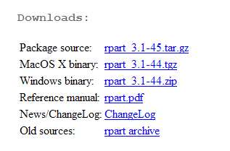
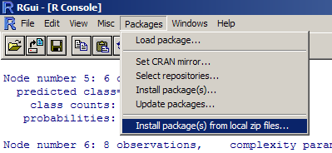
Implementing the Decision Tree in R
Step 4. Once you have downloaded R.
You will need to download some contributed extension packages.
The link for extension packages is on the home page of R.
Click
this for windows
download
Download
the rpart reference manual
Step 5. Once you have downloaded the package.
Install the package into R

Slide 38
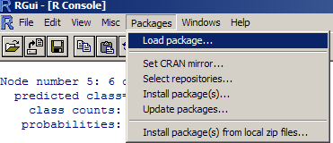
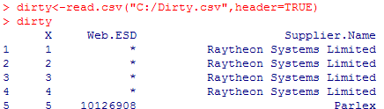
Implementing the Decision Tree in R
Step 6. Once you have installed the extension package in R.
Then, for every R session in which you want to use rpart, you
will need to load the rpart extension package.
Step 7. Upload the Dataset you want to analyze.
This command will read a csv file and
Put it in a memory location called “dirty”

Slide 39
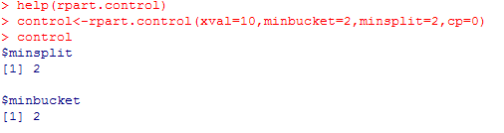
Implementing the Decision Tree in R
Y variable ~ X variables….
This command will fit your basic decision tree. It will prune it automatically. Method = ‘class’ corresponds to categorical Y’s.
Dataset name
If you want help with anything just type
Help(anything)
In this command I am
Specifying the cross-validation folds = 10, and complexity parameter = 0.

Slide 40
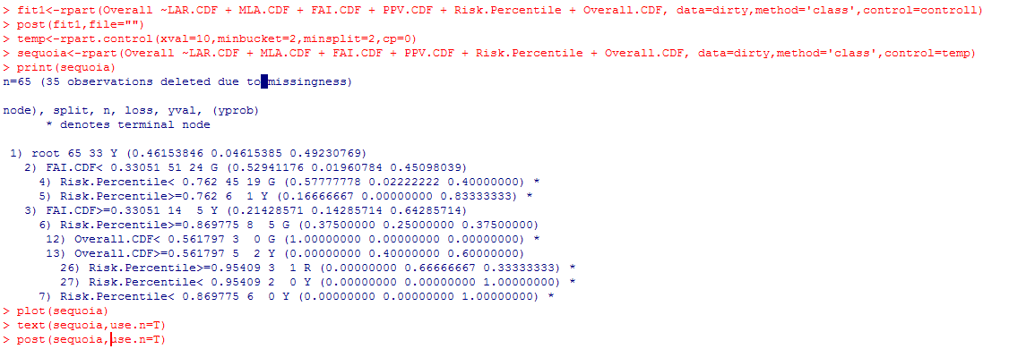
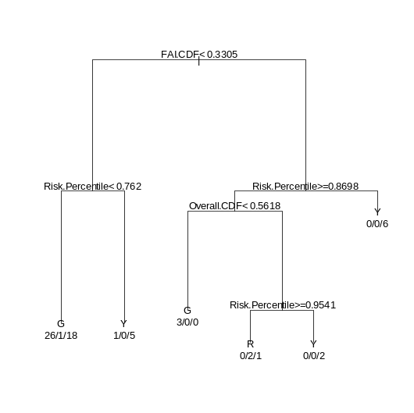
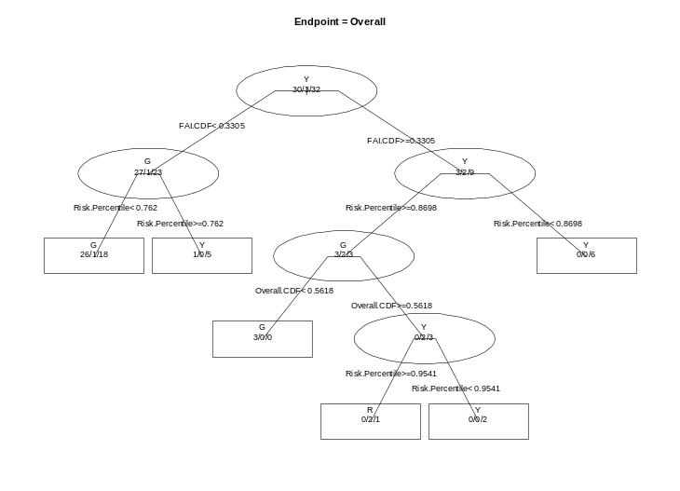
Implementing the Decision Tree in R
Plot(sequoia) text(sequoia,use.n=T) creates this
First line, fits the tree model using the control parameters
Creates a pretty plot

Slide 41
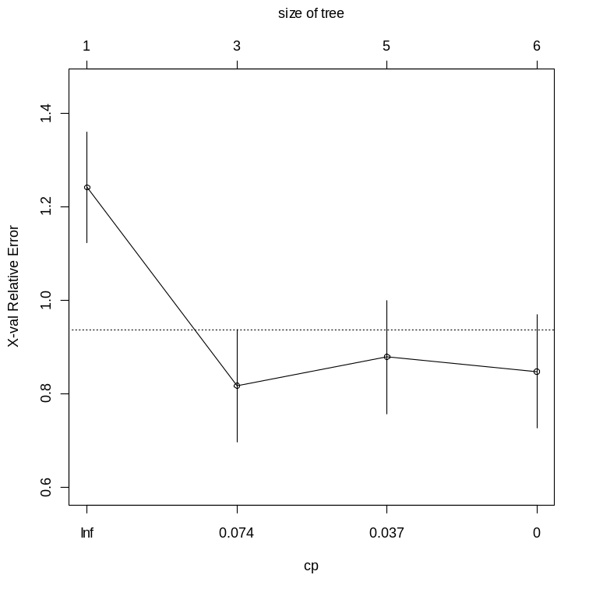
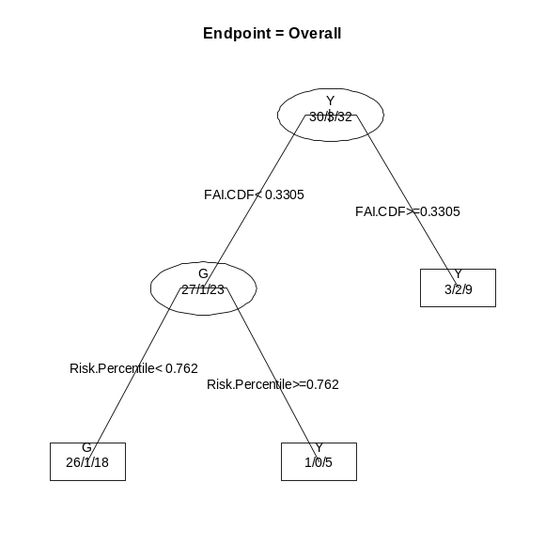

Implementing the Decision Tree in R
This command generates the cross-validation graph
This command generates the cross-validation graph

Slide 42
Summary Of CART
Split data and compute for each split
The algorithm is a “greedy algorithm”, it chooses maximum at every split
If Data is Missing, CART uses surrogate variables to classify them
Build the tree “all the way”, until no more splits are possible.
Compute the cross-validation as a function of the number of nodes
Finally, we prune the tree back -> final tree is most predictive one (Ockman’s Razor)

Slide 43
Advantages Of CART
CART can handle “Massive Datasets” (example: US Census data)
Procedure is Non-parametric and does not assume any particular distribution
Very complex interaction patterns can be analyzed (one relationship in a local
Region of X space and another relationship in another local area)
CART is not significantly affected by outliers in the X space
and only locally in the Y space
CART can handle any combination of categorical or continuous variables
CART can handle datasets with missing values (dirty data)
Interpreting a tree is simple and graphically intuitive

Slide 44
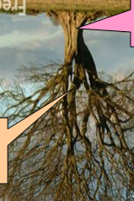



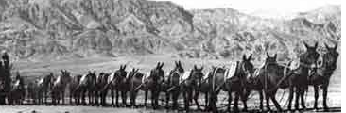

YES WE CAN Put The CART Before The Horses
THE HORSES
THE CART

Slide 45
Introduction To R Software
How To Download and Install Software On Your System
To read in a dataset
Some common R language
RPART Software Annotated Code And Output
Graphical Displays

Slide 46
Bibliography
Atkinson, E.J. and T. M. Therneau (2000). An Introduction to Recursive Partitioning Using the RPART Routine. Mayo Foundation. www.mayo.edu/hsr/techrpt/61.pdf
Breiman, L., Freidman, J., Stone. C.J., and R. A. Olshen (1984). Classification And Regression Trees. Chapman & Hall
Han, J., and M. Kamber. (2006). Data Mining: Concepts and Techniques. 2nd
Edition. Elsevier.
Nisbet, R., Elder. J., and G. Miner. (2009). Statistical Analysis & Data Mining Applications. Academic Press
J.R. Quinlan., (1986) “Simplifying Decision Trees.” Massachusetts Institute Of Technology – Artificial Intelligence Laboratory
R Software., (2009). Package ‘rpart’. Available on the web.
Shannon, C. E., (1948), “A Mathematical Theory Of Communication.” Bell System Technical Journal, 27, pp. 379–423 & 623–656, July & October, 1948
Teknomo,K. “Tutorial -Decision Trees” at http://people.revoledu.com/kardi/tutorial/index.html

